Slide 1
Das neue Gesicht des Tourismus - Griechenland ist anders
“Education, training and academic support
at the Tourism Sector”
Nicolas Moussiopoulos
Deputy Chairman International Hellenic University

Slide 2
Introduction (1/2)
Tourism is one of the biggest and fastest growing industries in the world
World Tourism Organization forecasts that international arrivals are expected to reach nearly 1.6 billion by the year 2020
Tourism and related activities are estimated to generate some 9.6% of the world’s GDP (World Travel & Tourism Council)
The tourism sector is the largest employer, accounting for some 225 million jobs or 10.7% of the global labour force (WTTC, 2008)

Slide 3
Introduction (2/2)
Greece was in 17th position as regards the number of international tourist arrivals and 21st as regards international tourism receipts (World Tourism Organisation, 2010)
In 2011, Greece:
was in 29th position out of 139 countries included in the Travel and Tourism Competitiveness Index,
while occupied the 83rd position in the Global Competitiveness Index (World Economic Forum).

Slide 4
Tourism demand trends (1/4)
The new challenge for the decision makers of the tourism sector seems to be the choice between supporting the conventional mass tourism activities or creating the conditions for the development of a new local tourism supply
The recent global economic crisis has spread rapidly all over the world and has adversely affected tourism
It has resulted in a decline of the tourist flows – both international and domestic – of employment and tourist spending
The negative economic impacts noted above are more serious in countries and regions that are more dependent on incoming tourism

Slide 5
Tourism demand trends (2/4)
Approach | Conventional tourism | New forms of tourism
Forms of tourism | Sun, sea and sand tourism (3S) | Alternative forms of tourism Agrotourism Ecotourism Cultural | Trekking Nature
 | Mountain (winter) tourism | Special Interest tourism Conference Business trips Maritime Religious | Health/spa Educational Sport Adventure
Mode of organisation | Mass tourism  Individuals  Social tourism  Second residence |  Small groups of tourists  Individuals  Social tourism
Tourist behaviour | Indifference High consumption (depletion of resources) |  Responsibility  Use of resources (not consumption)
State of tourism activity | Not sustainable tourism |  Green tourism  Economically sustainable tourism  Sustainable tourism
Source: Vagianni and Spilanis (2004)
Notes:
Different forms and states of tourism activities

Slide 6
Tourism demand trends (3/4)
Touristic development and management can be enhanced by implementing an integrated approach between specialized natural scientists and the tourist industry.
Greek natural and cultural resources should be inventoried and evaluated in order to establish composite market products.
Notes:
Touristic development and management can be enhanced by implementing an integrated approach between specialized natural scientists and the tourist industry.
Greek natural and cultural resources should be inventoried and evaluated in order to establish composite market products.

Slide 7
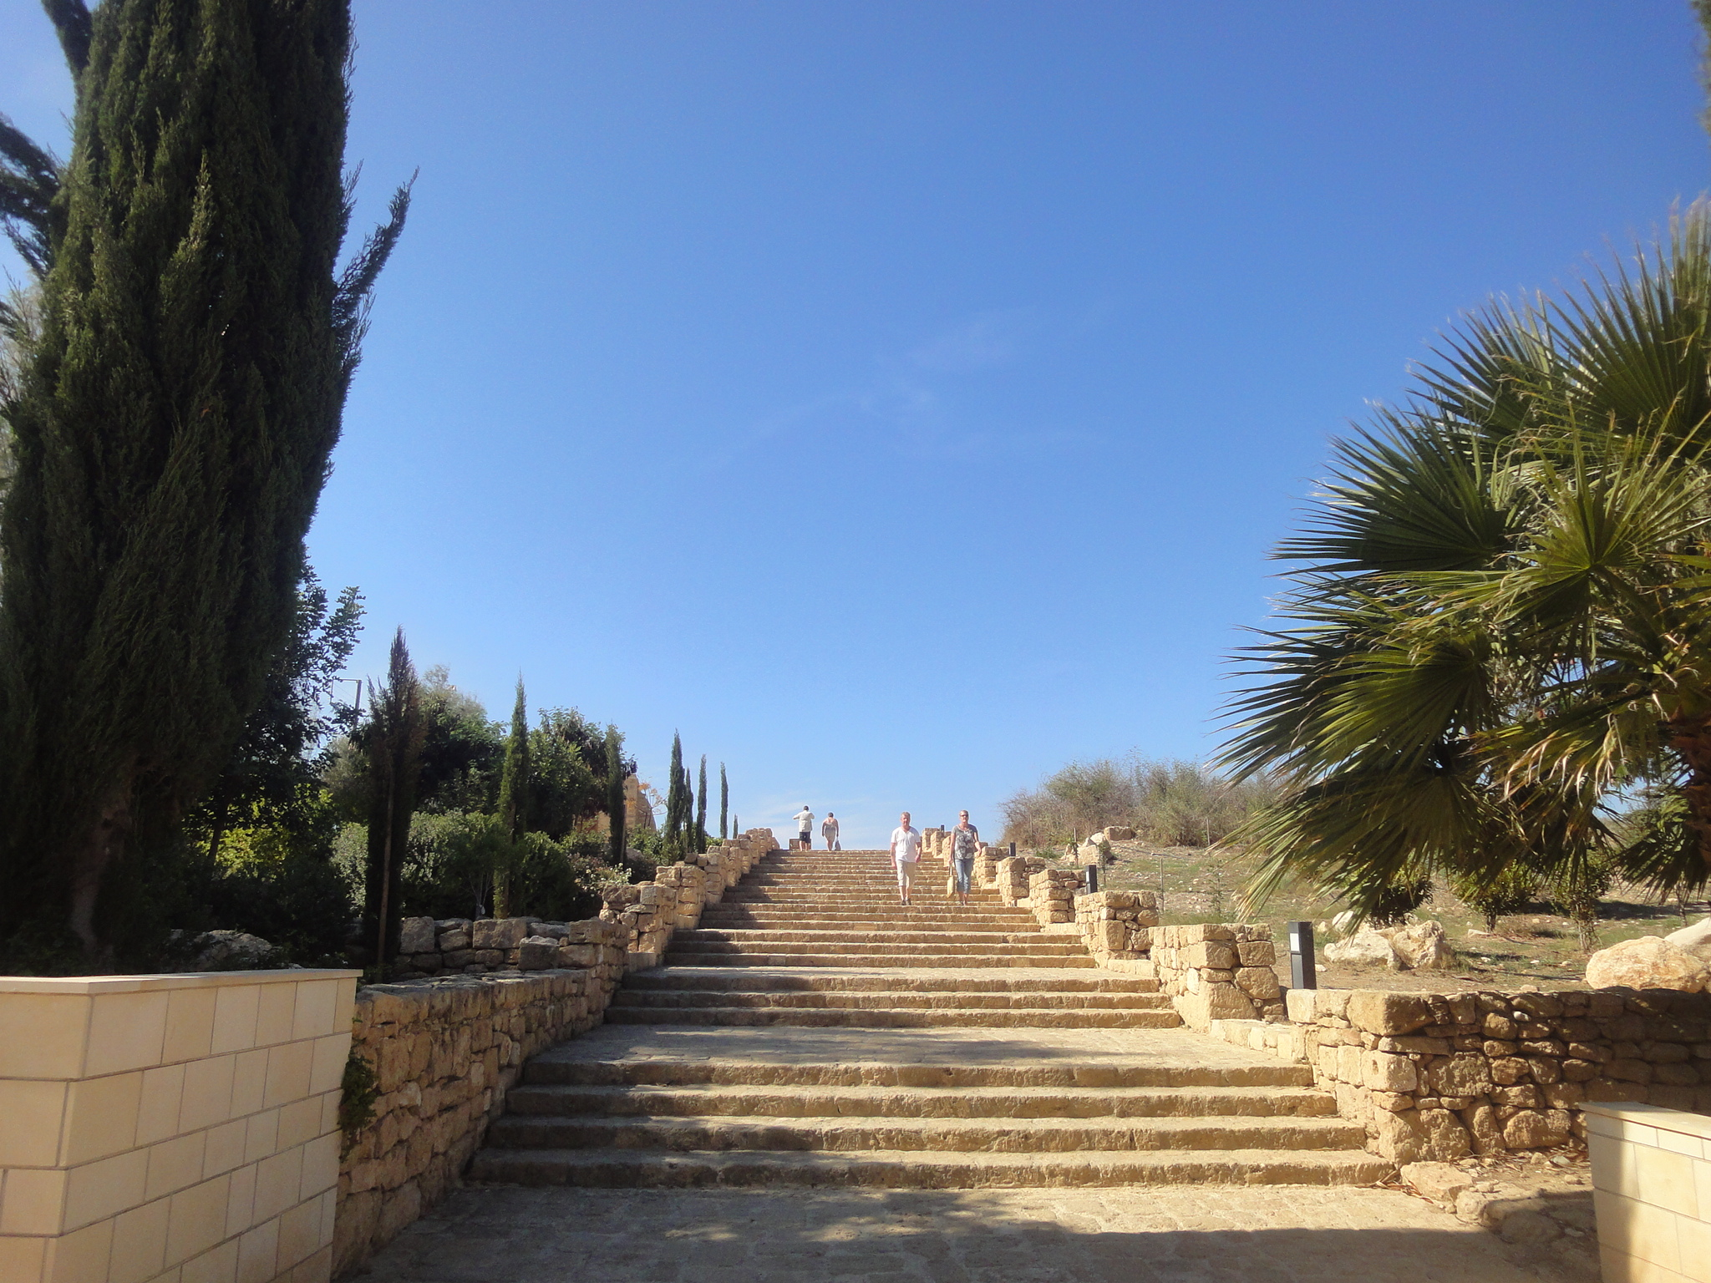
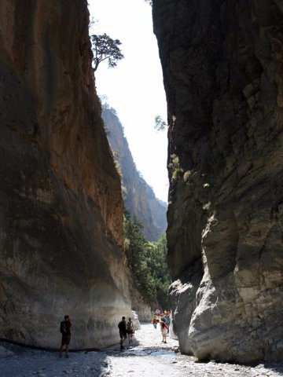
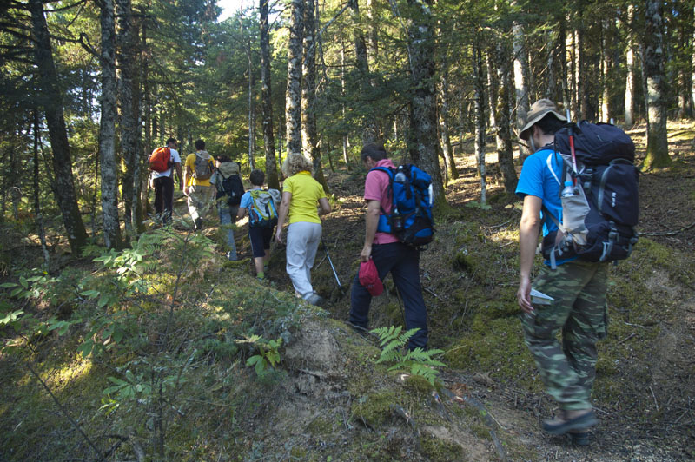
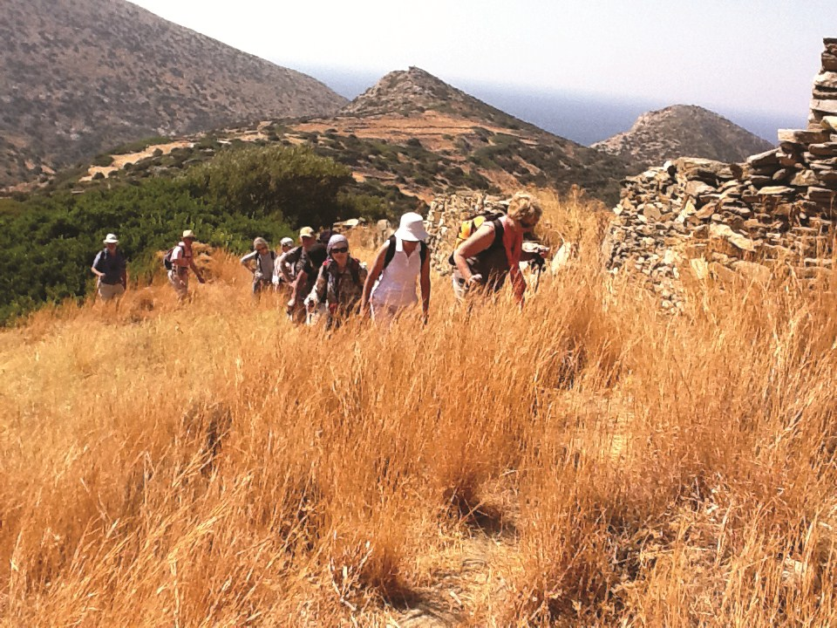
Tourism demand trends (4/4)
Notes:
Ecological or environmental tourism can be based on:
Natural landscapes of outstanding scenic beauty along with established ecological activities (forests, gorges, coasts etc.)
Cultural landscapes of special aesthetic quality (rural areas, historic sites, monuments)
Passive or active recreation based on natural activities (hiking, swimming, climbing etc.)
Educational entertaining projects for children and adults on environmental subjects (biodiversity, diversity of landscapes, wildlife etc).

Slide 8
Sustainable Practices: Energy Efficiency (1/3)
Importance of sustainability at the tourism sector:
Reduce energy costs
Promote ‘green’ efforts to increasing numbers of environmentally responsible consumers
Create an attractive environment to which guests are willing to return
Improved energy efficiency can lead to a more comfortable environment
Improve consumer services and enhance the perception of comfort and satisfaction
Improve management approach and system.

Slide 9
Sustainable Practices: Energy Efficiency (2/3)
Tips for improving the energy sustainability:
Understand where energy is used. Knowing what you pay for energy (electrical, heating or cooling) and how it is used are essential parts of efficient energy management
Reduce your energy needs and improve the efficiency of your energy operating systems
Install renewable energy systems to produce heating, cooling and electric power
Select low fuel consumption and low emissions company vehicles. Encourage guests to use sustainable transport options where available
Use an environmental management system to guide your efforts and promote your achievements by applying for a relevant eco-label
Involve staff by explaining your energy saving plan and ask for their suggestions. Involve your guests by informing them about your sustainable energy policy and kindly asking them to contribute to your efforts

Slide 10
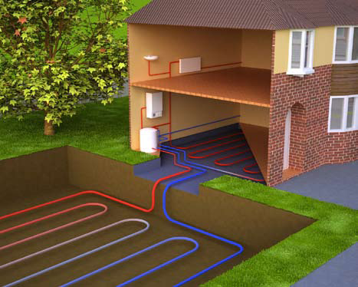
Sustainable Practices: Energy Efficiency (3/3)
Reducing Heating, Cooling & Water Needs:
Wall, Floor & Roof Insulation
Windows and Doors (Low-e)
Solar Protection
Place thermostatic valves on your radiators to significantly decrease your heating costs
Reducing Electricity Needs:
Installing a smart key card system
Installing lighting control systems
BEMS - Building Energy Management Systems
Renewable Heating & Cooling:
Solar water heating/cooling
Biomass heating
Install programmable thermostats
Water saving showers
and many more ……
Optimal use of daylight
Select efficient lamps and bulbs
Geothermal heating/cooling
Photovoltaic systems
Small wind turbines
Notes:
Using advanced glazing solutions such as Low-Emissivity (Low-E) and solar protection glass can significantly reduce the need for heating and cooling in buildings.
Decrease the energy consumption of hotel rooms by up to 80% by installing a smart key card system used in outdoor areas, corridors, stairs and indoor public areas (hall, lobby etc.).
Electricity consumption for lighting could be further decreased by installing lighting control systems. The main lighting control systems are:
Dimmer switches are devices used to manually vary the intensity of the light output, by decreasing or increasing the mean power to the lamp. They can be used in hotel bedrooms.
• Time switches are devices that are programmed to turn the light on and off at specified times (for instance during night hours 8.00pm - 7am). They can be used in outdoor areas, parking, corridors, stairs and indoor public areas (hall, lobby etc.).
• Motion detectors are devices that turn on lights when they detect any movement. In this way the energy consumption can be decreased up to
80%, as energy wastage when no one occupies the place is avoided. They can be used in low-trafficked outdoor areas, parking, corridors, stairs and public WC.
• Light level sensors are devices that turn on artificial lighting when they detect that the ambient light falls below a predetermined level. They can be used in outdoor areas, corridors, stairs and indoor public areas (hall, lobby etc.).

Slide 11
Sustainable Practices: Biomass Exploitation (1/2)
Exploitable biomass:
Grass
Wood
Prunings
Most attractive energy production technologies:
Anaerobic digestion
Mass burning
Produced energy may be sold to “Hellenic Transmission System Operator S.A.”
Produced heat may be used for several uses:
Indoor heating
Hot water (Rooms, Pools, etc.)
Cooking oil
Food waste
Sludge
Algae
and many more …...
Desalination
Drying of biomass
and many more ……

Slide 12
Sustainable Practices: Biomass Exploitation (2/2)
Alternative investments*:
Construction of an anaerobic digestion reactor (150 kW)
Investment costs: 2.2 M€
Annual operational costs: 110 k€
Investment amortization: 11 years
Internal Rate of Return (IRR): 6.1%
Construction of a biomass combustion plant (1 MW)
Investment costs: 5.5 M€
Annual operational costs: 670 k€
Investment amortization: 5 years
Internal Rate of Return (IRR): 18.5%
* only taking into account revenues from selling electric power to the Hellenic Transmission System Operator S.A., not heat production and use

Slide 13
Tourism Education (1/8)
Due to rapid developments and changes in the tourism industry, there is a necessity for a continuous training and education upon the latest trends
Establishing a link between academia and business is one-way road for obtaining a competitive advantage in a demanding sector such as tourism industry
Tourism education began as a development of technical/vocational schools in Europe
These schools emphasised training in core competencies such as hospitality, hotel management and related business skills
Interest and demand from the public and private sectors impelled rapid growth of tourism studies

Slide 14
Tourism Education (2/8)
Development, and establishment, of departments of travel and tourism at institutions of higher education in addition to technical schools
Debates over tourism programmes at universities appear to centre on the balance between vocational and academic focus
Tourism courses in higher education are often referred to as vocational with educators focusing on producing skilled and knowledgeable managerial personnel for the industry.
This emphasis has given short shrift to the value or meaning of tourism education

Slide 15
Tourism Education (3/8)
MSc in
Sustainable Development
Notes:
Different forms and states of tourism activities

Slide 16
Tourism Education (4/8)
The IHU MSc in Sustainable Development was designed to cover the need for rigorous training of business and organisations’ executives on the issues of sustainable development and the workings of the green economy
Emphasis is placed on the tourism industry due to its importance for the Greek economy and the region’s economic potential

Slide 17
Tourism Education (5/8)
Core Courses
• Intro to Env. Science and SD
• Business and the Environment
• Introduction to Env. Economics and Policy
• Strategic Planning and Env. Legislation
Sustainable Strategies
(corporate, society and state)
Required courses:
• Env. Management Systems, Auditing and Assessment
• Environmental Assessment, CBA
• International Env. Policy, Gov., Inst. and Stakeholders
• Quantitative and Research Methods
Sustainable
Tourism
Required courses:
• Sustainable Tourism Planning
• Strategic Marketing for Sustainable Tourism
• The economics of sustainable tourism
• Quantitative and Research Methods
Elective courses:
▪▪ Alternative Tourism
▪▪ Destination and Event Development
▪▪ Strategic Mangmnt in the Hospitality Industries and Tourism
▪▪ Technological Innovation in Tourism and Hospitality
▪▪ Climate change adaptation of the Tourism Industry
▪▪ Tourist Consumer Behaviour
▪▪ Contemporary Issues in Global Tourism
▪▪ Entrepreneurship in Tourism and Hospitality
Elective courses:
▪▪ Concept Engineering and Prototyping
▪▪ Low Impact Manufacturing
▪▪ Industrial Ecology and Life Cycle Assessment
▪▪ Environmental Accounting and Reporting
▪▪ Sustainable Production and Consumption
▪▪ Environmental Impact Assessment
▪▪ Strategic Environmental Assessment
▪▪ Climate Change and Energy Strategies

Slide 18
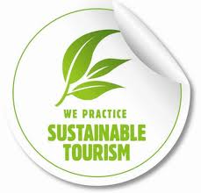
Tourism Education (6/8)
Sustainable Tourism
MSc’s Core Courses
Introduction to Environmental Science and Sustainable Development
Business and the Environment
Introduction to Environmental Economics and Policy
Strategic Planning and Environmental Legislation
Required Courses
Sustainable Tourism Planning
Strategic Marketing for Sustainable Tourism
The economics of sustainable tourism
Quantitative and Research Methods

Slide 19
Tourism Education (7/8)
Sustainable Tourism
Elective courses
Alternative Tourism
Destination and Event Development
Strategic Management in the Hospitality and Tourism
Technological Innovation in Tourism and Hospitality
Climate change adaptation of the tourism industry
Tourist Consumer Behaviour
Contemporary Issues in Global Tourism
Entrepreneurship in Tourism and Hospitality
Topics in Sustainable Development)

Slide 20
Tourism Education (8/8)
Sustainable Tourism
The Consulting Project
During the second semester, students can elect to undertake a consulting project relevant to the Stream they have joined. Students are encouraged to undertake their project within a sponsoring company, organisation or NGO. Either individually or organised in groups, students analyse real life problems of a particular firm or organisation or sector, provide solutions and design sustainable strategies.
The Master’s Dissertation
In the last semester, students choose a dissertation topic relevant to the courses of the MSc programme. The topic is chosen by the student with input and advice from a faculty member, who acts as the supervisor, working closely with the student.

Slide 21
Employment prospects in sustainable tourism
In 2010, the contribution of tourism to Greek GDP amounted to 15.4%, while total employment in tourism (754,400 jobs) corresponded to 17.1% of the workforce
Up to 360,000 jobs could be created in the tourism industry by 2019, corresponding to 100% of the unemployed in Greece in 2009
The main employment sectors in the tourism industry are:
Hotels, accommodation, food and beverage
Tourism services, travel agencies and tour operators
Examples of Leading businesses in Northern Greece:
Notes:
ΕΟΤ
Σανη Α.Ε.
Μακεδονία Παλας
Ξενοδοχειακές Επιχειρήσεις –Ηλέκτρα Α.Ε.
Ζορπίδης Τουριστικός Οργανισμός
Miramere Τουριστική Α.Ε.
ΕΛΕΜΚΑ τουριστικές επιχειρήσεις
Porto Palace
Delta Hotelia Α.Ε.
Domotel
Metropolitan
Ledra Hotels and Villas
Olympic εμπορικές και τουριστικές επιχειρήσεις Α.Ε.
Καψής Α.Ε.

Slide 22
Employment prospects in sustainable tourism
Nonetheless, the insufficient utilization of scientific resources in both research and academic sector has led to the problem of brain drain, with severe impact on the growth rates and the competitiveness of the country
On the other hand, the diffusion of new scientific knowledge and practice through work experience abroad could lead towards the opposite direction
Under this perspective, the emigration of employers and experts at the tourism industry can be a vehicle to increase competitiveness; provided that the vast majority of them will return to Greece

Slide 23
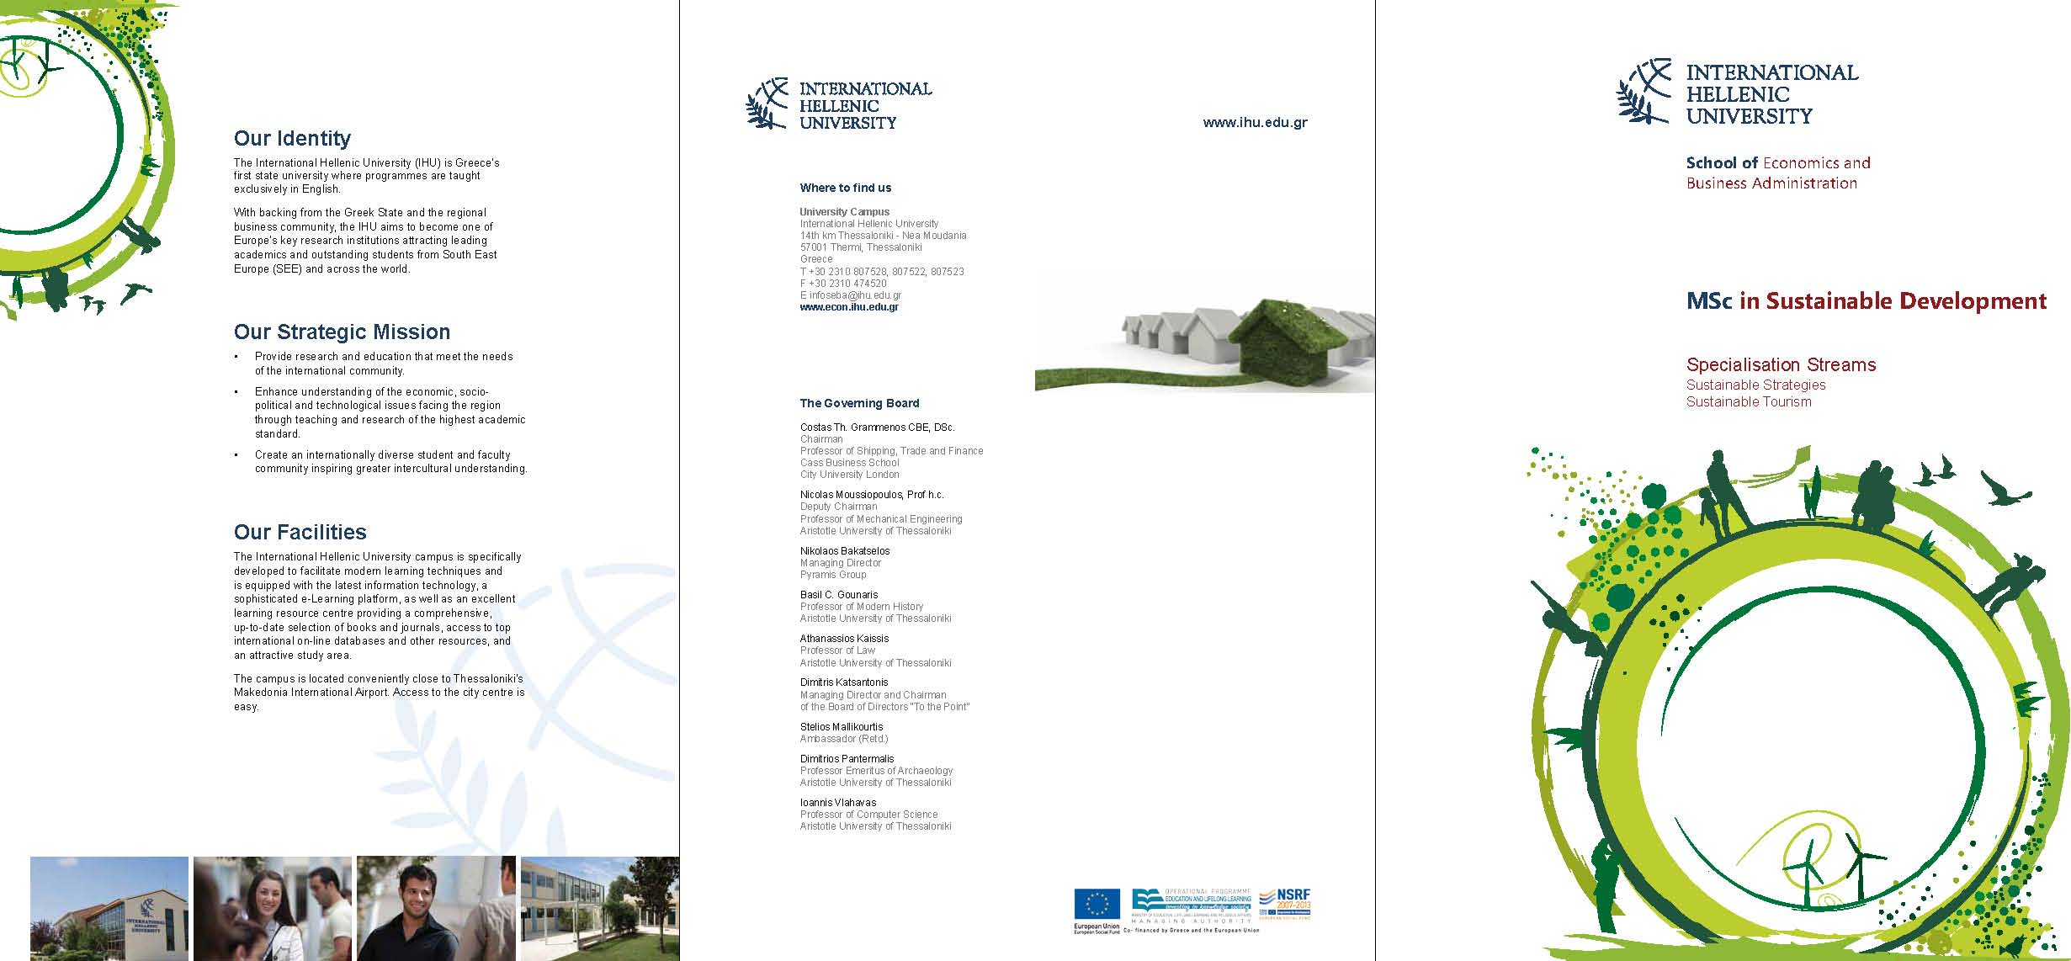
MSc in Sustainable Development
Contact:
14th km Thessaloniki - Nea Moudania
57001 Thermi, Thessaloniki, Greece
T +30 2310 807528, 807522, 807523
F +30 2310 474520
www.ihu.edu.gr
Follow us on:

Slide 24
Strategies and Best Practice in Local Government
Thank you for your attention!
For more details: n.moussiopoulos@ihu.edu.gr

