Slide 1
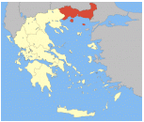
Eastern Macedonia and Thrace The charming undiscovered Greece
Let’s communicate it!
Καλημέρα.

Slide 2
OVERVIEW
Industrie-Contact AG / Presenter
The German tourist and the German tourism market
Eastern Macedonia and Thrace
Smart communication
Trade shows
Branding

Slide 3
Industrie-Contact AG Agency for Public Relations and Communications

Slide 4
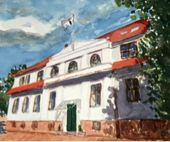
AGENCY AT A GLANCE
FOUNDED 1979
LOCATION Hamburg, Germany
STATUS Independent, run by owners
QUALITY German VDWA Agency Quality Seal 2010-2012
TEAM 17
NETWORK Public Relations Global Network
MEMBERSHIPS German PR Association German Journalists‘ Association Marketingclub Hamburg
FOCUS Tourism, Food & Beverages, Building & Habitation, [ B2B & B2C ] Industry, Logistics & Transportation

Slide 5
SKILLS
CONSULTANCY Communication strategies & concepts, corporate identity, crisis PR
MEDIA RELATIONS Press releases, case studies, by-lined articles, interviews, media road shows, press conferences, cooperations
INTERNET Social Media, blogs, website design, SEO
EVENTS Tradeshows, exhibitions, conferences, seminars
MEDIA e-Newsletters, brochures, books, trade magazines, business reports
MARKETING Advertising planning, advertisements, mailings
PUBLIC AFFAIRS Concept, background information, contacts

Slide 6
REFERENCES TOURISM
Airline Consumer + Trade PR, Fair PR (ITB)
Lounge & Spa Consumer + Trade PR
Luxury Resort Consumer PR
Luxury Resort Consumer PR
Hamburg Hotel Consumer PR
Mali Fair PR (ITB)

Slide 7
The German tourist and the German tourism market

Slide 8
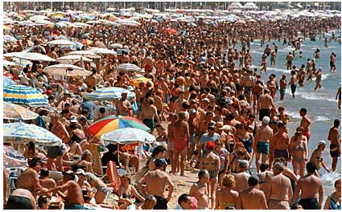
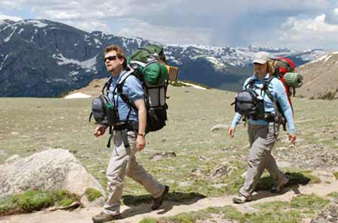
WHO IS THE GERMAN TOURIST? 2 STEREOTYPES
Beach
Nightlife
Sun
Ocean
Nature
Wildlife
Sites
Culture

Slide 9
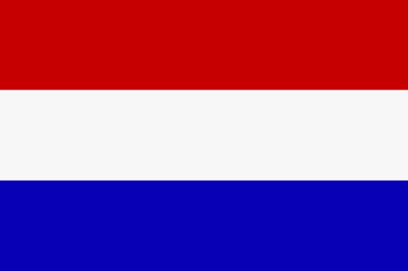
Germans most popular vacation COUNTRIES (TOP 10)
Source: Fakten und Zahlen zum deutschen Reisemarkt 2011, Eine Übersicht zusammengestellt vom Deutschen ReiseVerband (DRV)
Spain | 12,3 %
Italy | 8,2 %
Turkey | 7,4 %
Austria | 5,2 %
France | 3,0 %
Croatia | 2,7 %
Greece | 2,6 %
Poland | 2,3 %
Netherlands | 2,1 %
Denmark | 1,8 %

Slide 10
German tourism market
Greece is still among the most popular vacation destinations. Last year more than 2,5 million Germans traveled Greece. So there is still al lot potential!
Source: Deutscher ReiseVerband (DRV)

Slide 11
Eastern Macedonia and Thrace has a lot to offer

Slide 12
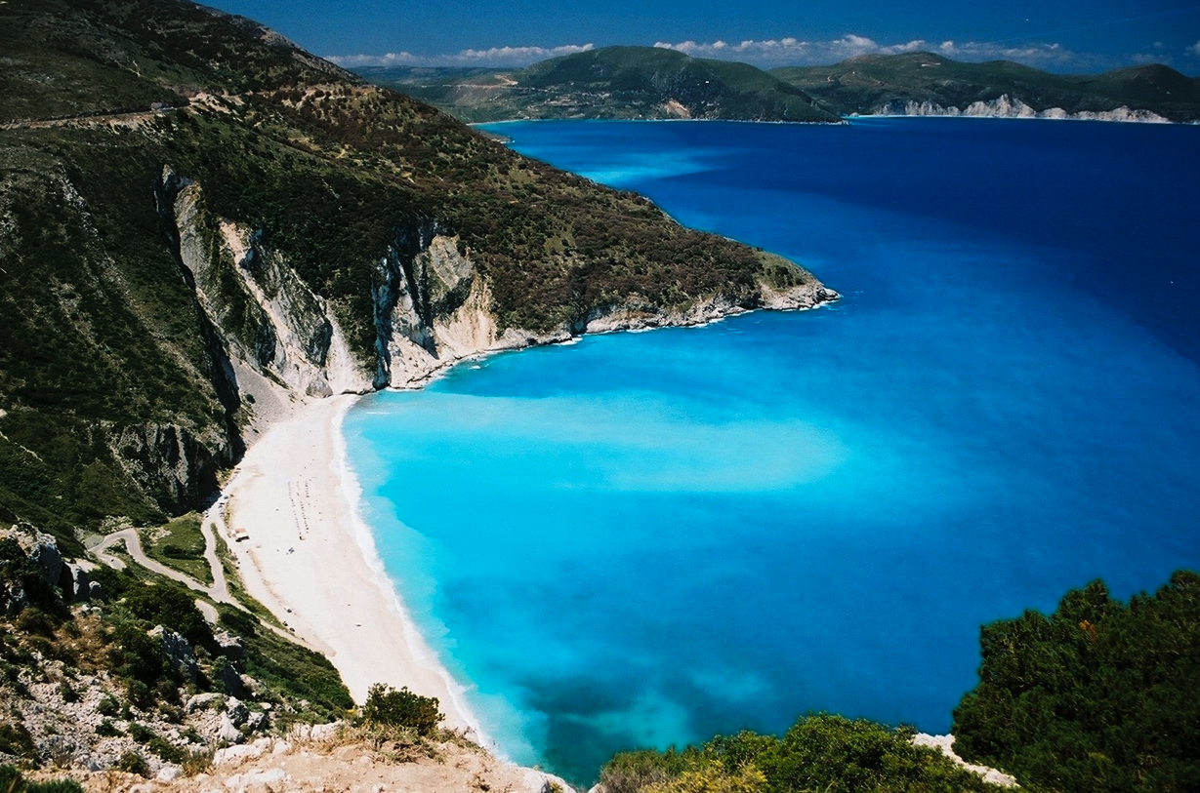
Eastern Macedonia & Thrace has a lot to offer
The Mediterranean Sea
Warm climate
Unspoiled nature

Slide 13
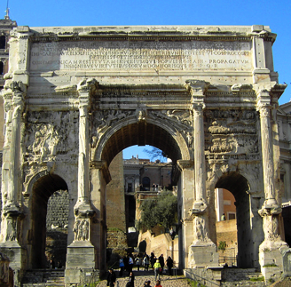
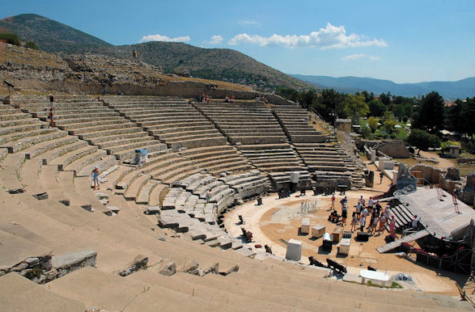
Eastern Macedonia & Thrace has a lot to offer
Sites

Slide 14
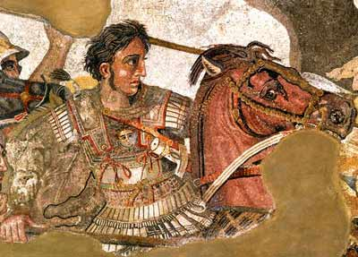
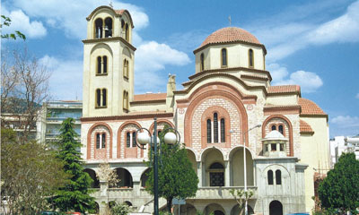
Eastern Macedonia & Thrace has a lot to offer
Rich history and culture

Slide 15
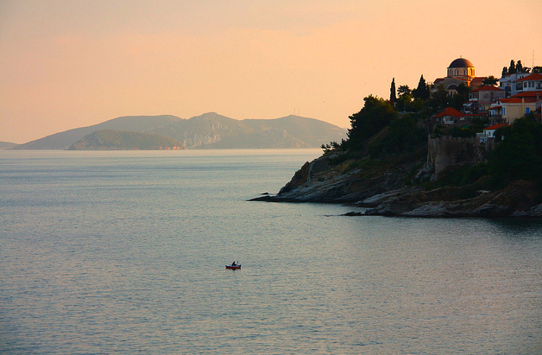
Eastern Macedonia & Thrace has a lot to offer
Romantic and inspirational landscapes, e.g. Kavala

Slide 16
Eastern Macedonia & Thrace has a lot to offer
High infrastructural level
Many (direct) flights from Germany to Thessaloniki and Kavala e.g. from Hamburg, Munich, Dusseldorf, Cologne, Nuremburg, Stuttgart

Slide 17
Summary
Germans are travel champions
Germans generally like to travel Greece
It’s easy to get to Eastern Macedonia & Thrace from Germany
With all what Eastern Macedonia & Thrace has to offer you reach out to
the German tourist stereotypes
and all those who can be found in between

Slide 18
Conclusion
You got everything German tourists like but they don‘t know it.
Let‘s communicate it!

Slide 19
Smart Communication

Slide 20
Smart communication
Do it smart beyond EXPENSIVE advertising campaigns
Communicate through media / press
Focus on EDITORIAL ENTRIES, reach your target groups and save money!

Slide 21
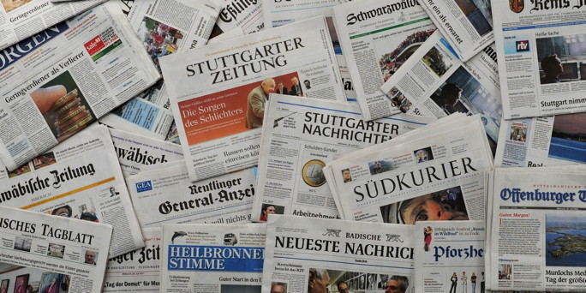
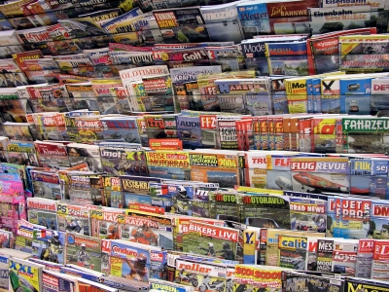
Target media
Print media
Newspapers
Consumer special interest leisure & travel
Trade magazines
Broadcast
Online media

Slide 22
Print media in Germany
About 400 newspapers with a total circulation of about 26m readers
About 13,500 magazines with a wide range of subjects
About 36 million readers

Slide 23
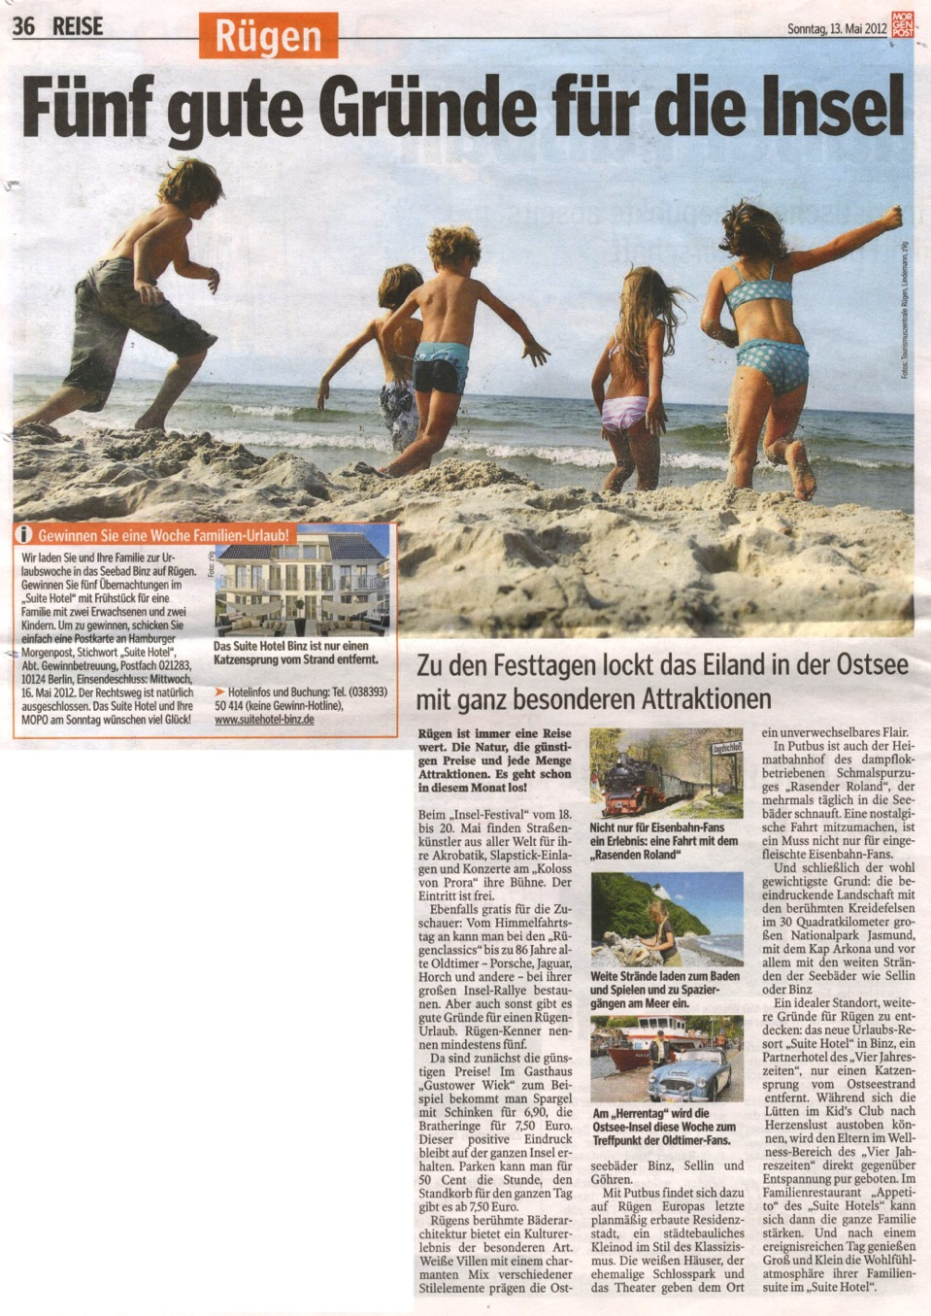
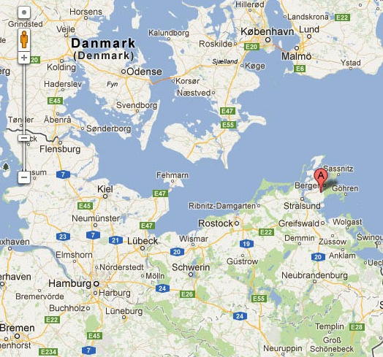
Example: Rügen

Slide 24
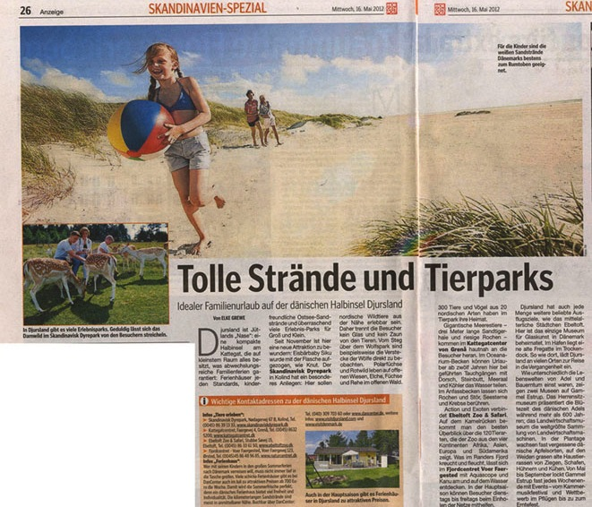
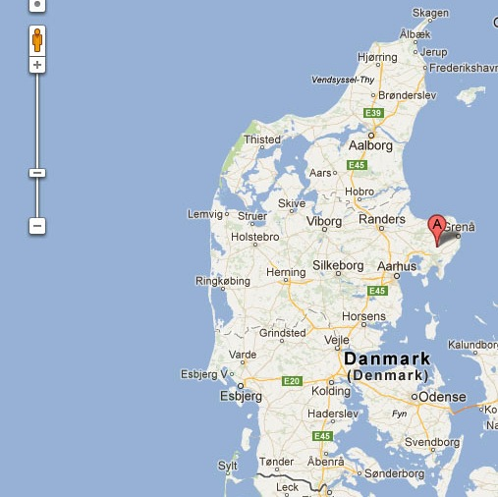
Example: Djursland

Slide 25
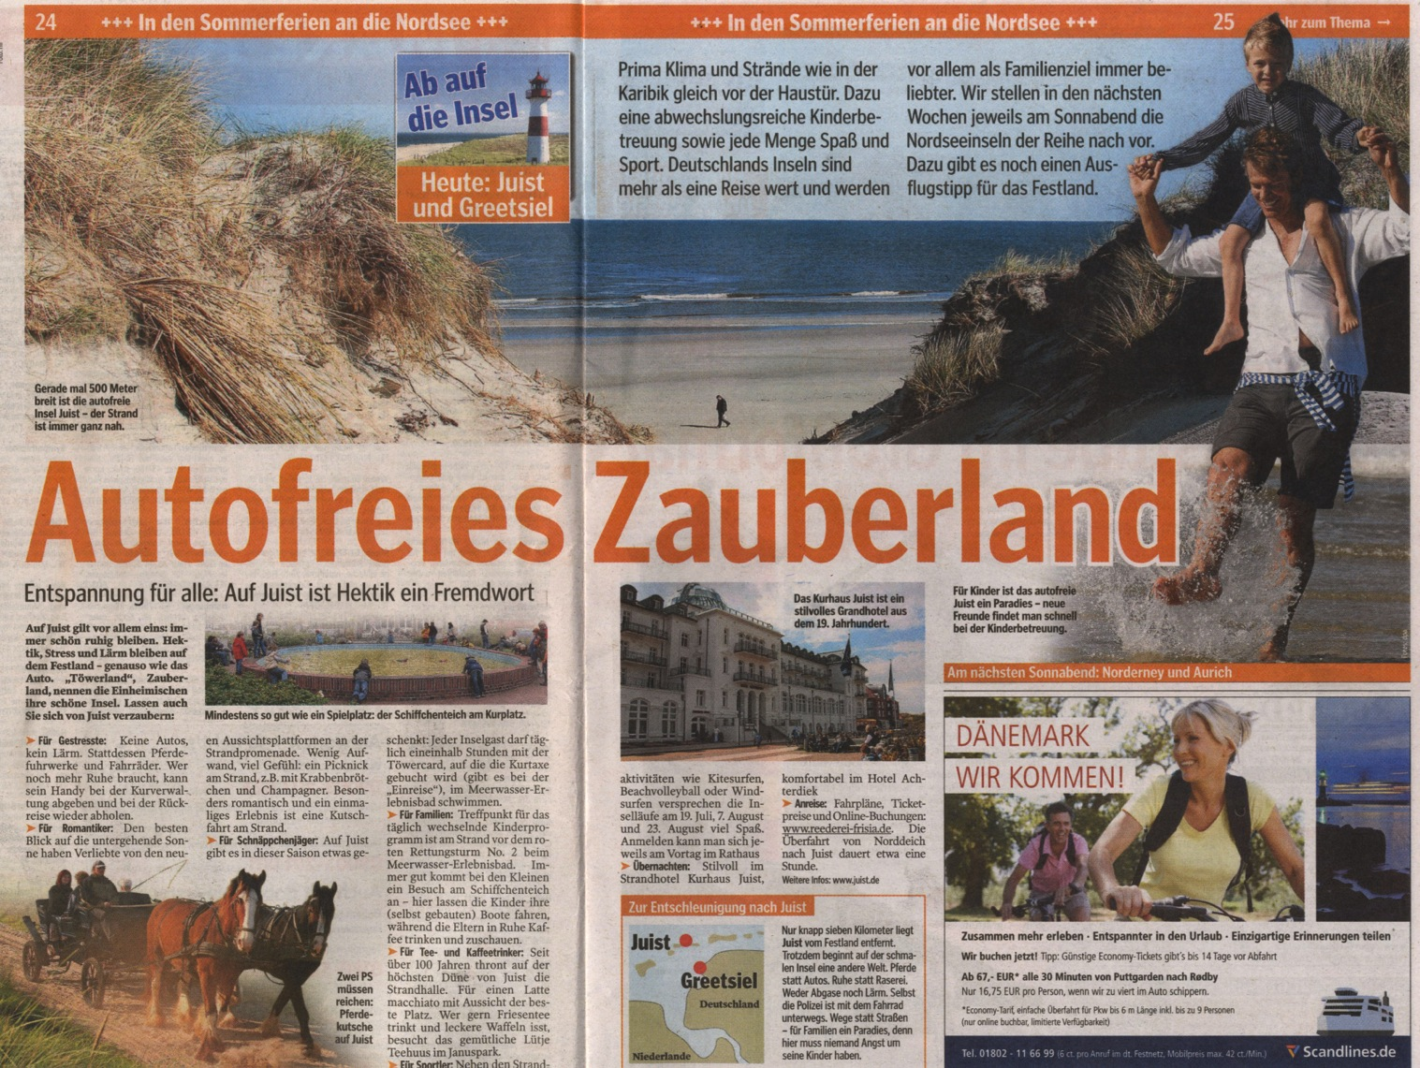
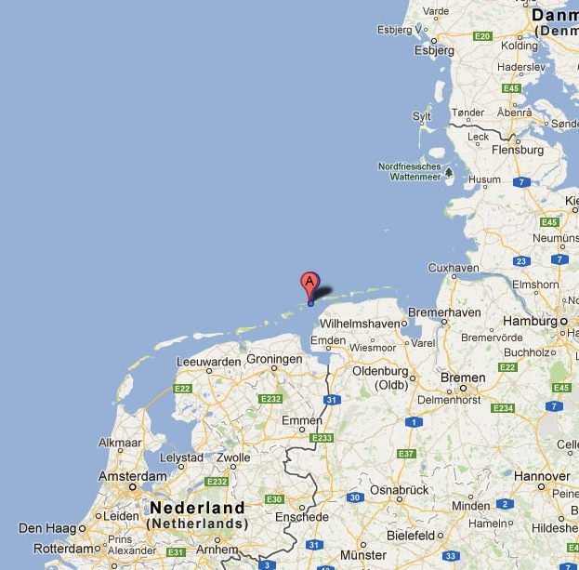
Example: Juist

Slide 26
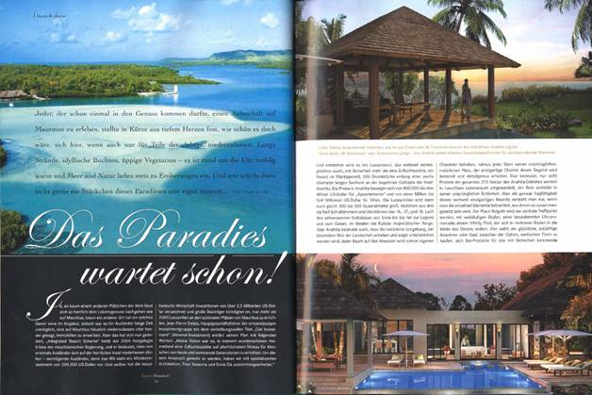
Example: Mauritius

Slide 27
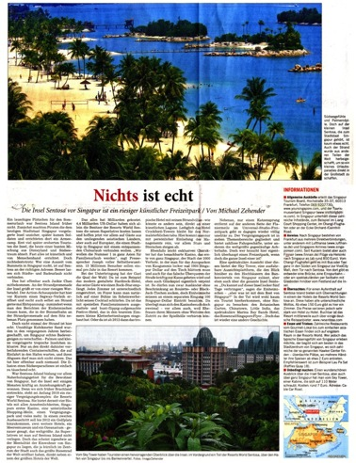
Example: SEntosA

Slide 28
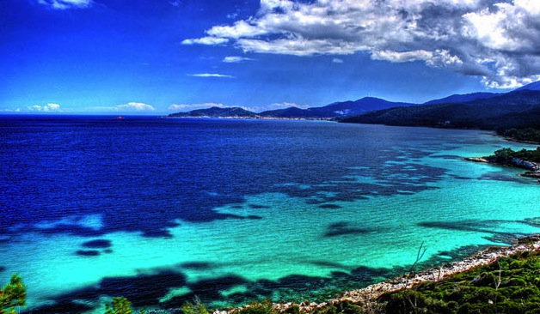
TV in Germany
Again:
Focus on EDITORIAL ENTRIES

Slide 29
How to achieve your communication goals
Press office in Germany - through PR agency:
Writes Basic press kit incl. background information, nice pictures and incentives for top journalists
Writes seasonal / thematic Press releases several times per year
Developes Media list and pitches media on-going
Offers Interviews to journalists
Developes Electronic press kit (TV footage)
Organizes Press trips - invitation to Eastern Macedonia & Thrace → Educational trip / adventure trip / ecotourism / trekking trip

Slide 30
Your media angles and story lines
Turn your weak spot into your strong side: Eastern Macedonia & Thrace = Unknown and unspoiled: Perfect for people looking for new experiences!
Nature (beaches, ocean, landscapes)
Historical sites
Eco tourism
Hiking / Trekking
Boat tours
Fine food and wines
Spas / wellness

Slide 31
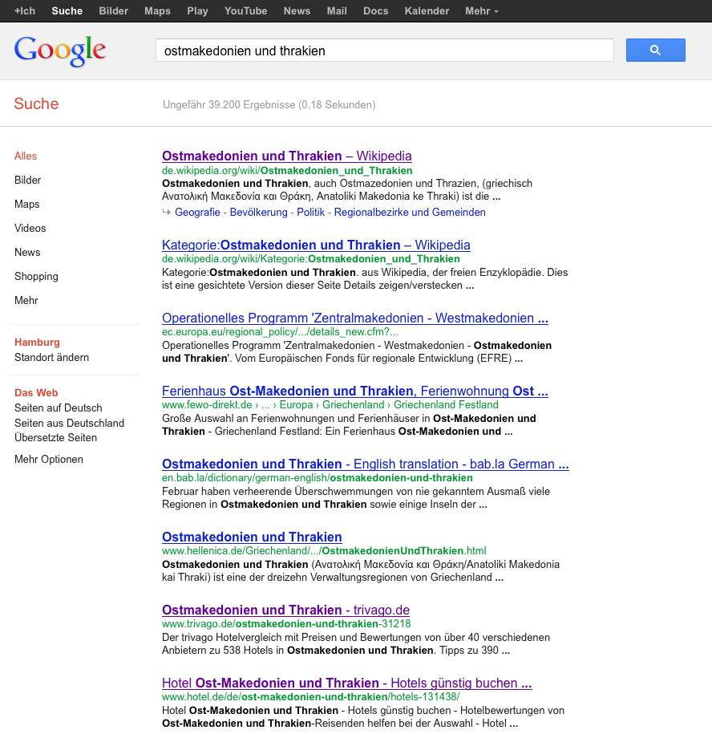
Give a chance to inform oneself online!
Optimize Google Page 1 search results
Add qualitative search results
Optimize existing search results
+ Landing page
+ Facebook site

Slide 32
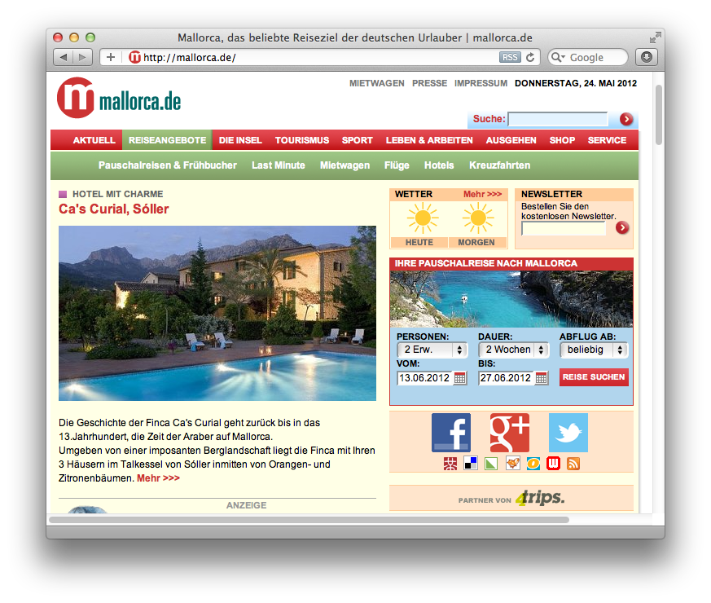
Landing page
Excellent example: www.Mallorca.de

Slide 33
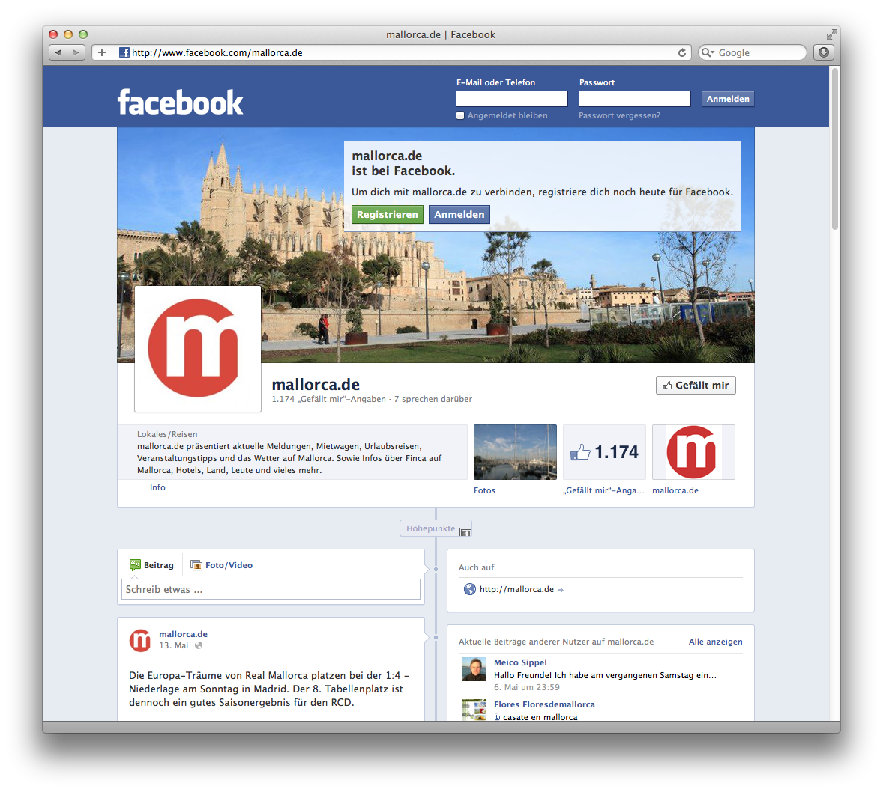
Facebook Site

Slide 34
Wikipedia
Add history
Add tourism
Add culture and sites …

Slide 35
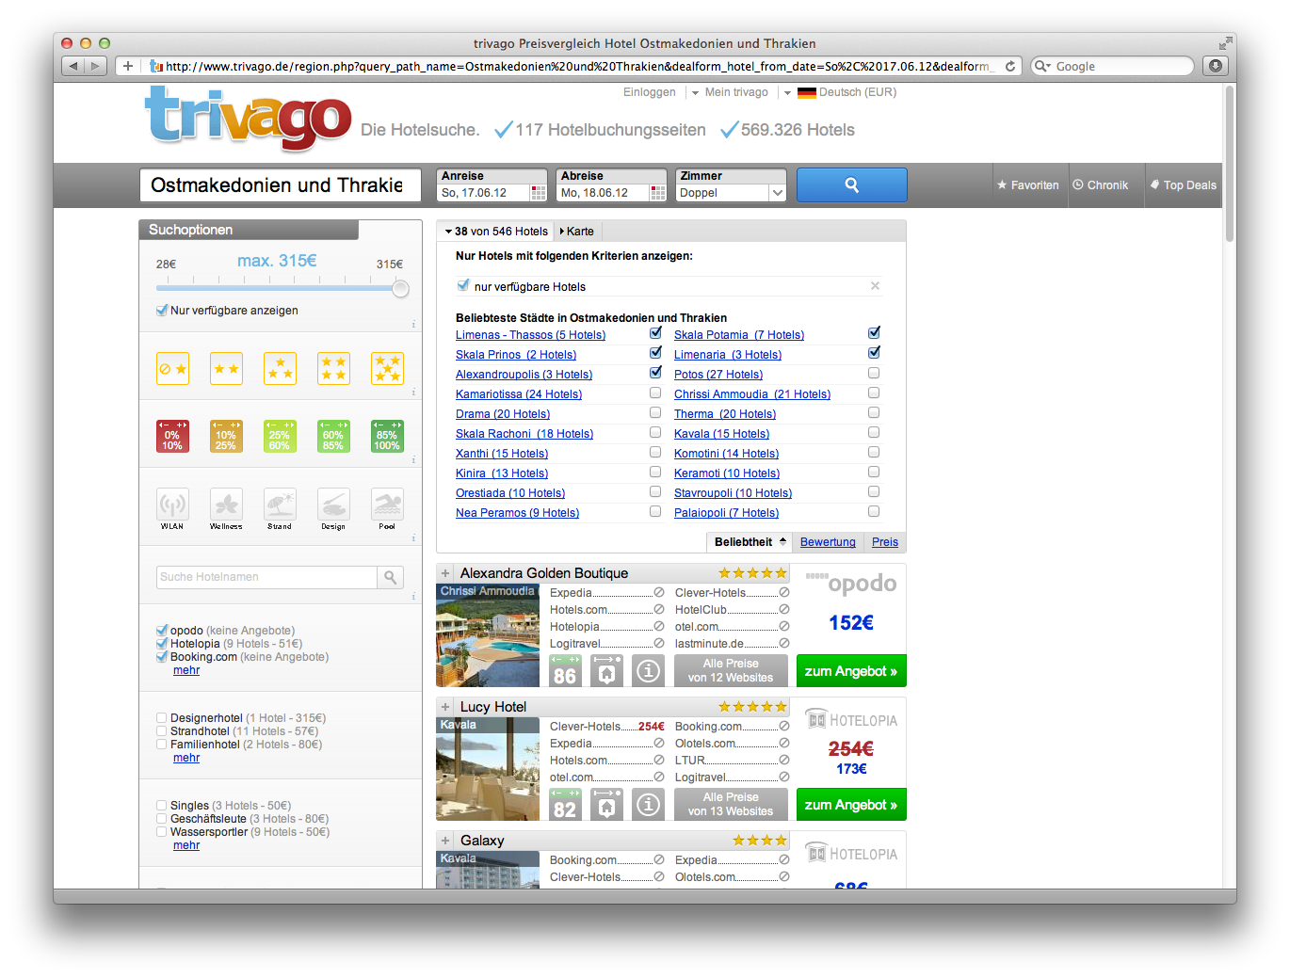
Travel websites e.g. Trivago
Edit / develop / provide texts
Provide pictures
Add comments and travel reports

Slide 36
Trade Shows

Slide 37
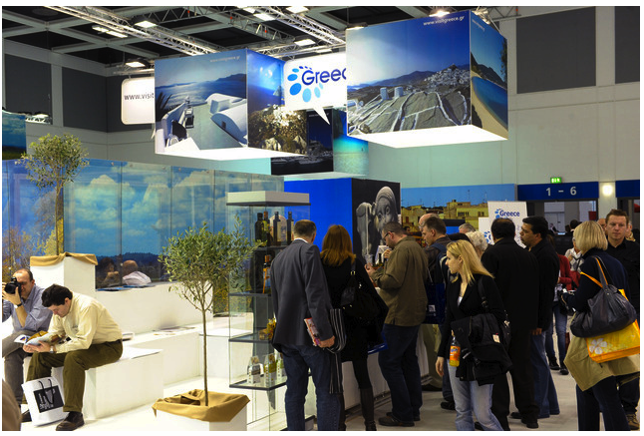
How the Region gets attention in Germany
Trade Shows!
ITB Berlin - the most important tourism fair in the world!

Slide 38
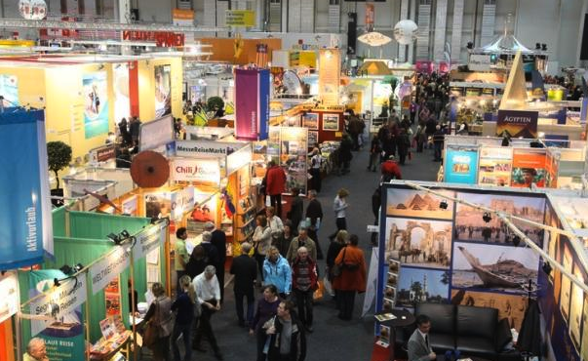
Trade Shows
Further opportunities: Regional & topic shows, e.g. hiking

Slide 39
Trade Shows
Use trade shows not only for marketing but also for communicating with journalists (double strategy)
Develop press kits print and digital
Provide them at the booth and in the media center
Invite newspapers and magazines to your stand: Make appointments with journalists (no press conference!)

Slide 40
Branding

Slide 41
Branding
You need a logo

Slide 42
Branding
You need a slogan and clearly defined key messages
“Eastern Macedonia and Thrace –
Discover the charming unknown Greece
A cradle of European culture.”

Slide 43
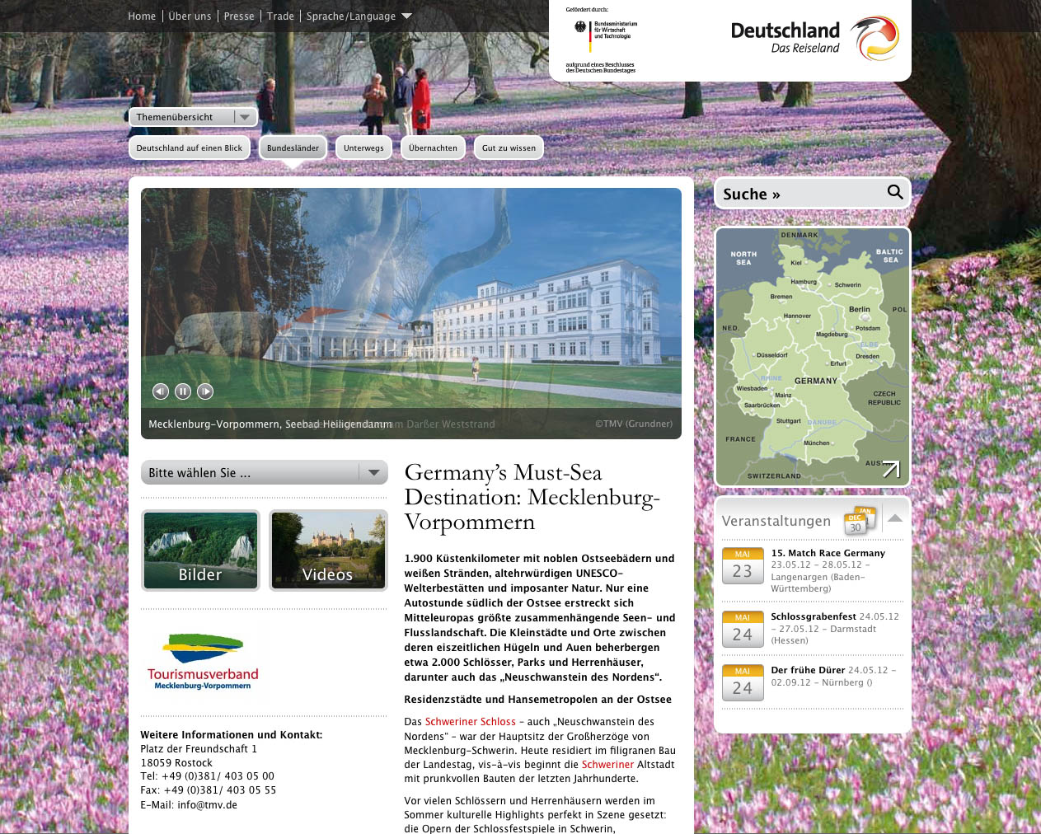
Branding
You need a boiler plate – a core summary of what you are and offer

Slide 44
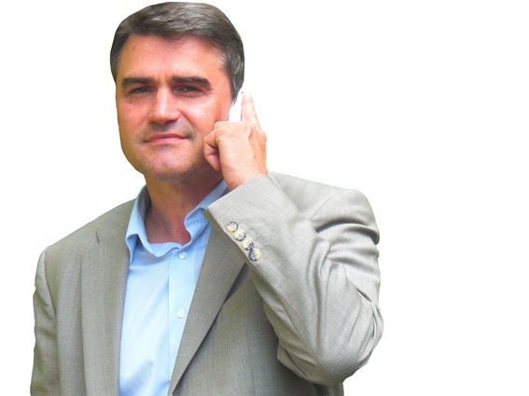
Σας ευχαριστούμε! Uwe Schmidt
Industrie-Contact AG
Bahrenfelder Marktplatz 7 22761 Hamburg, Germany
+49 40 899 666 0
uwe.schmidt@ic-gruppe.com
www.ic-gruppe.com www.publicrelations-germany.com
facebook.com/ICPublicRelations

